Slide 1
Cloth Amortization
Timothy Luciani Mitchell Luban

Slide 2
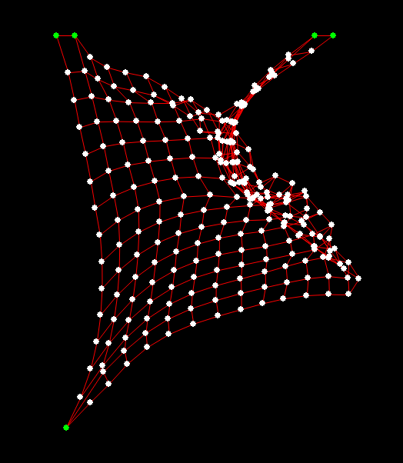
outline
Description and Design
Goals
Implementation
Results and Setbacks
Future Work

Slide 3
outline
Description and Design
Goals
Implementation
Results and Setbacks
Future Work

Slide 4

Description and design
Cloth Simulation:
Trivial (ish)
Doable
Somewhat inexpensive
So why…?

Slide 5
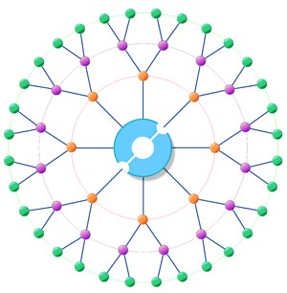
Description and design CONT.
Simplicity for one user can open many doors
Easy to parallelize
Not Impossible to Amortize
Since the same simulation will be viewed on many machines
Every machine do the same computation?!

Slide 6
outline
Description and Design
Goals
Implementation
Results and Setbacks
Future Work

Slide 7
GOALS
Scene with multiple flag simulations
Texturing and Vertices using VBOs
Multi-client functionality
Multi-server functionality
Realism

Slide 8
outline
Description and Design
Goals
Implementation
Results and Setbacks
Future Work

Slide 9
IMPLEMENTATION
Backend machine(s) running cloth simulation
Time steps in background as well
Responsible for actual simulation
Frontend machine(s) rendering scene
Requests initial data such as global scene, textures etc…
Each frame requests the most recent time step from the backend
Completely independent view of other clients

Slide 10
outline
Description and Design
Goals
Implementation
Results and Setbacks
Future Work

Slide 11
RESULTS AND FEEDBACK
Initially, the CPU proved Faster than the GPU
Due to the overhead of Cuda
After Amortizing the cloth
Numerous cloth ran without hindrance to one another
Ram was the bottle neck for running multiple clients on one machine

Slide 12
outline
Description and Design
Goals
Implementation
Results and Setbacks
Future Work

Slide 13
FUTURE WORK
Normals and lighting added to the scene
Handshake improved upon (by transmitting global scene)
Allow for multiple servers
Currently we are only able to have one server with many clients

Slide 14
DEMO!!

Slide 15
Questions?

